Slide 1
Feedback Compensation Control
SOEN385
Control Systems and Applications

Slide 2
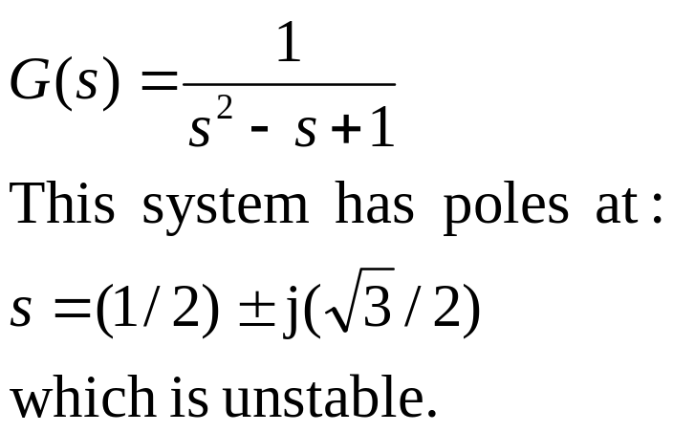
Feedback Compensation
In this example we see how to control a second order system which is unstable in open-loop.
“To control” means “To make the output stable and satisfy certain other specifications”
The open-loop plant has transfer function

Slide 3
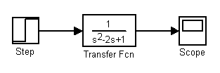
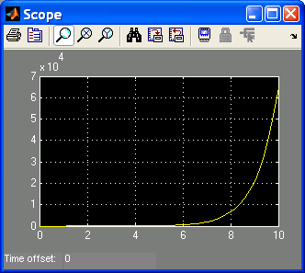
Feedback Compensation
Simulink simulation:
It is desirable to add a feedback compensator to K(s) move the poles to the desired positions.

Slide 4
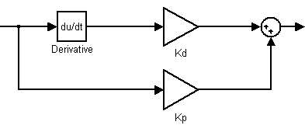
Feedback Compensation
For this example, let the compensator be the Proportional-Derivative (PD) feedback type:
K(s) = kDs + kP
With the following Simulink implementation:

Slide 5
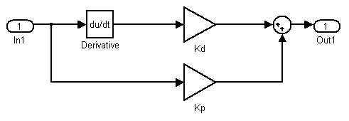
Feedback Compensation
We better hide the unnecessary implementation details in a black-box.
In Simulink we can do this by creating a subsystem:
  Insert input and output ports and connect the ports appropriately:
  Select the whole implementation, right click and then choose Create Subsystem.

Slide 6
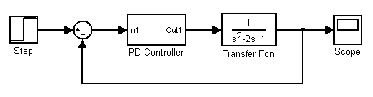
Feedback Compensation
Now we add the feedback compensator (PD controller) to the model:
The problem is now how to find proper values for kD and kP?

Slide 7
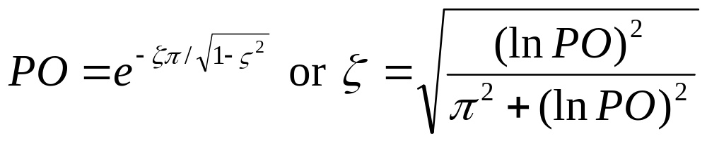
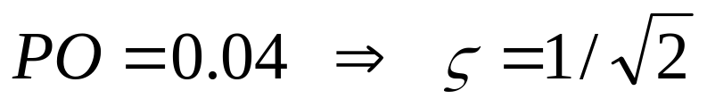
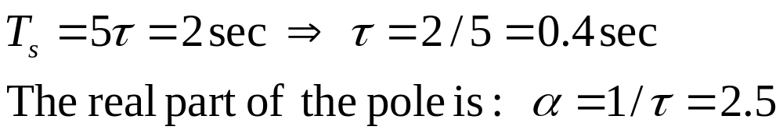
Feedback Compensation
First we want to make the system stable; and also assume we want the following performance specifications: P.O. = 4% and settling time = 2 (sec).
Solution:

Slide 8
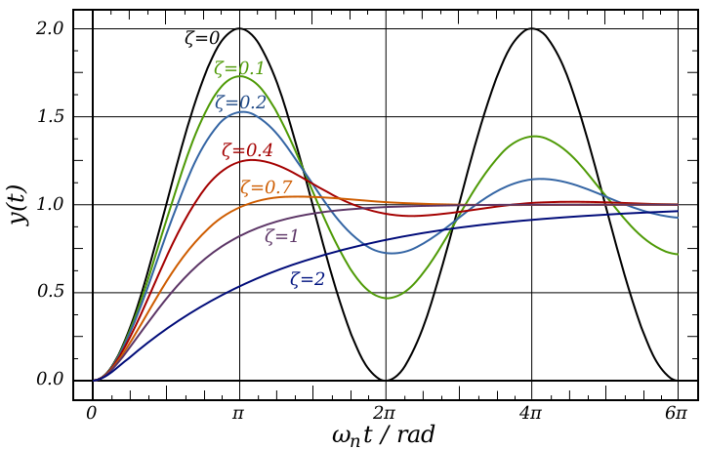
Review: Damping Ratio
The damping ratio is a dimensionless measure describing how oscillations in a system decay after a disturbance.
2nd order damping ratios:

Slide 9
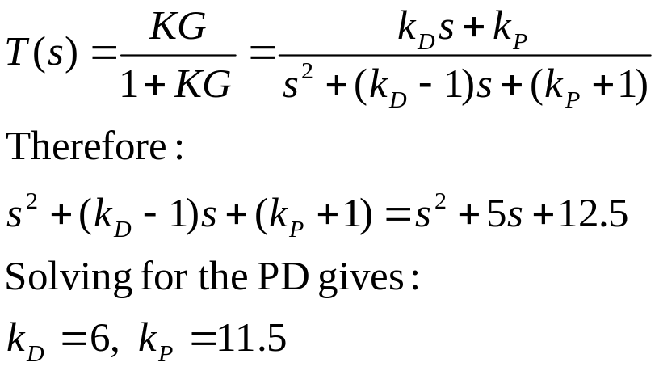
Feedback Compensation
We can satisfy the specifications by selecting:
Then the desired characteristic polynomial:
The closed-loop transfer function is:

Slide 10
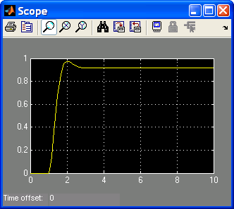
Feedback Compensation
Simulink simulation:

Slide 11
References
Simulink
Simulation and Model-Based Design
http://www.mathworks.com/access/helpdesk/help/pdf_doc/simulink/sl_using.pdf

